Slide 1
2022 Annual Open Enrollment
For
City of Tyler
https://www.brainshark.com/bbandt/COTOE22
Notes:
Welcome to the 2022 Annual Benefits open enrollment for the City of Tyler. The City is proud to provide you and your family with valuable and significant benefits. Today, we are going to walk through an overview of the benefits that are available to you, current changes to benefit offerings as well as instructions for you on how to complete and have a successful open enrollment. The benefits discussed in this presentation will become effective on January 1, 2022.

Slide 2
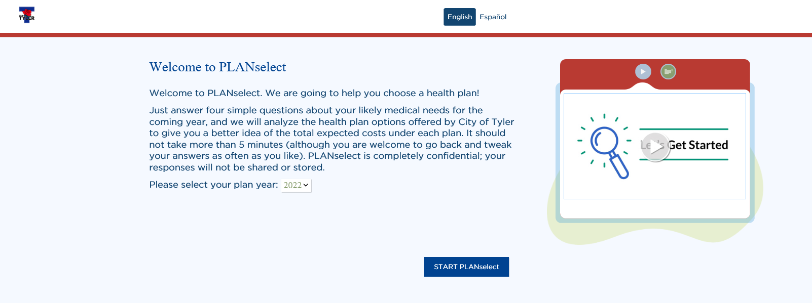
What’s New?
New
Medical Plan Options
  Rose Plan & Azalea Plan
  New Rates
Decision Support Tools
  PLANselect
    PLANselect: Medical Plans
  Run multiple scenarios
  Based on the actual average cost of claims for the zip code you enter.
Notes:
We are excited to announce that we will have 2 medical plan options for the 2022 plan year. The Rose Plan and the Azalea Plan. The Rose plan mirrors the current medical plan we have in place. The Azalea plan is a new plan option you will have. We will go into more detail about the differences between these 2 plans later in the presentation. Your medical rates will be changing with the addition of this new plan. See page 7 of your benefits guide for a full outline of your rates. To help you decide which plan to choose, the City has implemented a decision support tool. PLANselect will be exclusive to the medical plan options. By now you should have received an email that includes the link to this tool. All you need to do is click on the link and then follow the prompts and answer the questions. The tool will then make a recommendation on which medical plan would work best for you. You can complete the questions as many times as you like if you would like to see how different scenarios would work. PLANselect uses actual claims data for the zip code you enter to help you determine which plan would be the most cost effective for you.

Slide 3

Open Enrollment 2022
November 1st – November 12th
Open Enrollment
  Passive enrollment – current elections will rollover
    Those enrolled in medical who do not complete OE will be defaulted into the Rose Plan
  November 12th deadline for elections/changes
  Online through HealthFirst Portal
  Q&A Sessions
  Online Enrollment Assistance Sessions
Mid-Year changes can only be made if you experience a Qualifying Event
  Marriage or Divorce
  Birth or adoption
  Loss of coverage elsewhere
  Medicare eligibility
Notify Team Resources to request change within 30 days of Qualifying Event
Notes:
Open Enrollment will start on Monday, November 1st and run through Friday, November 12th. While this year’s open enrollment is a passive enrollment, all employees are strongly encouraged to explore and compare the 2 health plan options and choose the plan that best meets the needs of you and your family as well as review all of your benefit plan options. For those who do not complete the open enrollment process, and who are already enrolled in medical, will be defaulted into the Rose plan. All other current benefit elections will rollover. Enrollment will be completed online through the HealthFirst benefits portal. The HealthFirst portal will open on Monday November 1st and will run through Friday, November 12th. All enrollments must be submitted by November 12th, if you plan to make any changes or choose which medical plan to enroll in. Anyone needing help with their enrollment can attend one of our Q&A sessions or Online Enrollment Assistance Sessions. The schedule for these dates will be discussed towards the end of this presentation.
Make sure when deciding on your benefit elections for the upcoming plan year that you remember that once open enrollment is complete and the new plan year starts, you will not be able to make any changes to your benefit elections unless a qualifying event takes place. Examples of qualifying events are marriage, divorce, birth or adoption, loss of coverage elsewhere and Medicare eligibility. When making a mid-year change you must complete a change form and provide the required documents to Team Resources within 30 days of any of these qualifying events or wait until the next open enrollment period. Additional details on qualifying events can be found on page 6 of your benefits guide.

Slide 4
Enrolling in Benefits
1
2
3
Review your benefit plan options
Decide which plans work best for you and your family
Make your elections at hfbenefits.vbagateway.com
Tips
  Review your Benefits Guide & Utilize the Decision Support Tools available to you
  Review each vendor’s website and consult their online provider directories
  Have you recently been married, divorced or had a baby? Did your spouse or dependents recently gain or lose coverage through an employer?
Notes:
When deciding which benefits to enroll in for the upcoming plan year, it’s important to take the time to review your benefit plan options and decide which plans works best for you and your family. Once you have made your final decision on which plans you would like to enroll in for the 2022 plan year and complete your online enrollment.
Here are some tips to help you be successful during this year’s open enrollment. Make sure you review your benefits guide. There is a lot of valuable information located throughout this guide. Your guide is also a great resource to keep on hand throughout the year. Make sure to review the Health First, Delta Dental and Superior Vision websites and consult their online provider directories for their medical, dental and vision plans. Lastly, have you or your dependents recently had a change in coverage due to marriage, divorce, birth or the loss or gain of coverage through another employer? Keep these details in mind when making your elections for this open enrollment.
As a reminder if you need to make changes to your beneficiaries, life insurance elections or to update your address, please contact Team Resources.

Slide 5
Medical Plan
Notes:
Next we are going to review details regarding your medical plan.

Slide 6



Finding an In-Network Doctor – AccessDirect Platinum (ADP)
Step 1: Go to www.adppo.com
Step 2: Click “Find a Provider”
Step 3: “Agree” to terms
Step 4: Enter 0070053 in the “please enter your group #” box, then click “next step”
Step 5: Enter your Zip Code or City and check whether you are looking for a “facility” or “physician”
Step 6: You can search for a physician by name or by specialty
Notes:
To search for in-network providers in the platinum access direct network go to www.adppo.com and click on the find a provider link. Agree to the terms and then on the next screen you can enter 0070053 as the group number into the “please enter your group number box” and then click “next step”. Now enter the zip code or the City that you are searching in and be sure to specify whether you are searching for a physician or facility. When searching for a physician you can search by either the provider name or specialty. If you do not have access to a computer contact Team Resources at (903) 531-1100 for assistance.

Slide 7



Finding an In-Network Doctor – Outside of ADP Service Area
Step 1: Go to www.uhss.welcometouhc.com/find-a-doctor
Step 2: Click “United Healthcare Options PPO”
Step 3: Make sure to “change location” to the location you are searching in
Step 4: You can search by doctor name, specialty, facility name, clinic name or medical group name physician by name or by specialty
Accessing Cerpass RX Portal
Go to www.cerpassrx.com
  Access claims history
  Order home delivery
  Compare prices of your prescriptions
  Learn about medication side effects
  Locate a pharmacy
Notes:
To search for in-network providers in the wrap UHC network go to www.uhcss.com.welcometouhc.com/find-a-provider and click on the “United Healthcare Options PPO”. Make sure to change the location to area that you are searching in. You can then search by doctor name, specialty, facility name, clinic name or medical group name.
Cerpass RX is the City’s pharmacy network provider and will remain so in 2022. If you haven’t already, go to www.cerpassrx.com and register your account. The Cerpass RX portal allows you to access your claims history, order prescriptions for home delivery, compare prescription costs, learn about the side effects of your medication and locate a network pharmacy. Remember if you do not have access to a computer contact Team Resources at (903) 531-1100 for assistance.

Slide 8

Emergency Room Copay
Accidental Injury & Emergency Care
  $350 copay (Azalea) / $250 copay (Rose)
Non-Emergency Care in the Emergency Room
  20% coinsurance in the AccessDirect Platinum Network
  30% coinsurance In-Network/Other Counties
  Out-of-Network – no coverage
Notes:
As a reminder, the copay for in-network emergency care is $350 on the Azalea Plan and $250 on the Rose Plan. If after going to the emergency room you are admitted to the hospital the copay will be waived. Your cost for emergency room care depends on the network you use and whether or not the care is a true emergency. If it is not a true emergency your cost will be as follows: a $350 copay on the Azalea Plan or a $250 copay on the Rose Plan plus a 20% coinsurance in the Platinum Access Direct Network or a 30% coinsurance if the provider is in-network/other counties. There will be no coverage for non-emergency care at an out of network emergency care facility.

Slide 9


Urgent Care Locations
The following Urgent Care locations are in-network with ADP:
  UT Health East Texas Urgent Care – South Broadway (6210 S. Broadway Ave)
      Faculty is an Urgent Care and an ER – note with intake team that you are seeking Urgent Care and not Emergency Room Services.
  Texas Spine and Joint Urgent Care – South Broadway (8101 S. Broadway Ave)
In addition, UT Health East Texas has extended hours / walk-in hours at their 5th street location for pediatricians & family medicine & also the S Broadway location for family medicine
  5th Street walk-in hours are:
    Saturday, 9:00 am – noon
  S Broadway extended / walk-in hours are:
    Monday – Friday, 7:00 am – 7:00 pm
    Saturday, 9:00 am – 4:00 pm
    Sunday, noon – 5:00 pm
  https://uthealtheasttexas.com/locations/extended-hours
Notes:
Utilizing an urgent care center is a convenient and affordable alternative for getting care for minor illnesses and injuries. In order to avoid higher copays, make sure the urgent care facility you use is in-network. The copay for in-network urgent care utilization is the same a doctor’s office copay, which is $30 on the Rose Plan and $40 on the Azalea Plan. (PLEASE NOTE IT IS YOUR RESPONSIBILITY TO MAKE SURE THAT THE DOCTOR AND/OR CLINIC YOU USE IS IN THE Access Direct Platinum NETWORK)

Slide 10
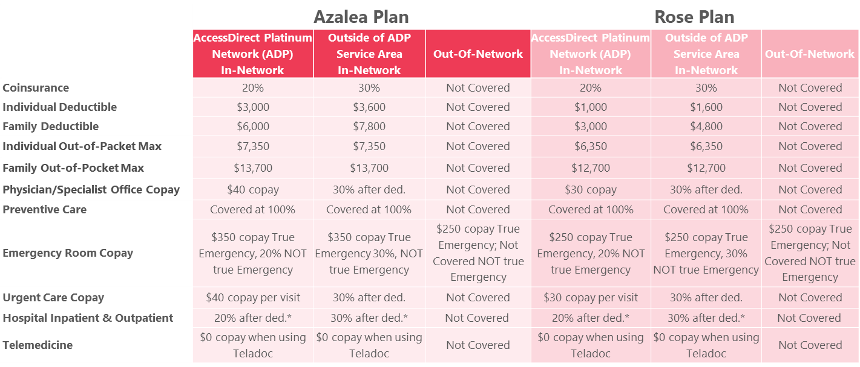
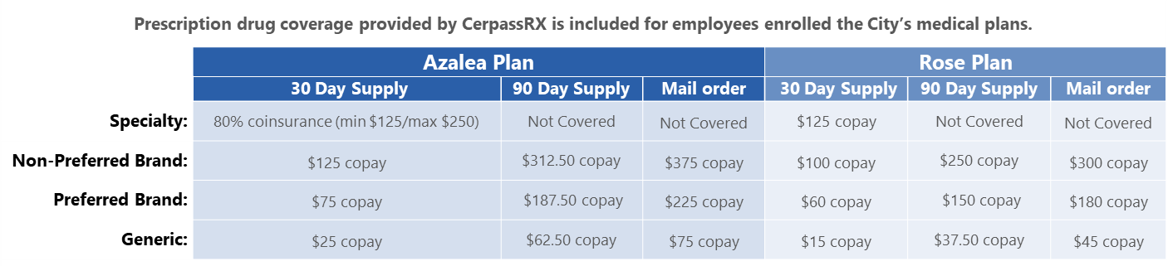
Your Medical Benefits
This is an abbreviated list of services, see the carrier plan documents for full plan details.
Notes:
This schedule of benefits is a quick reference for you to see what medical and prescription benefits you have available to you. It also includes details about the portion you will be responsible to pay depending on which network you utilize and which plan you choose. The main differences between the Azalea and Rose plan can be found in the deductibles, out of pocket maxes and the copays for emergency room visits, urgent visits, physician and specialist office visits. Both plans pay 100% for preventive care and telemedicine benefits are a $0 copay. You prescription benefits are provided by Cerpass RX. Your 2 medical plan options have different copay structures for the RX. This is just a summary of your benefits, please refer to your summary plan description or the schedules located in your benefits guide on pages 8 & 9.

Slide 11

Your Medical Premiums
 | MedicaL plans
 | Azalea Plan |  | Rose Plan
 | Employee Per Pay Period Contribution | Employee Monthly Contribution ($) | Employee Per Pay Period Contribution | Employee Monthly Contribution ($)
Contributions
Employee Only | $25.00 | $50.00 | $53.57 | $107.13
Employee +Spouse | $122.86 | $245.71 | $178.62 | $357.23
Employee + Child(ren) | $108.57 | $217.14 | $138.79 | $277.58
Employee + Child(ren) (4+) | $112.50 | $225.00 | $155.68 | $311.35
Employee + Family | $170.00 | $339.99 | $242.03 | $484.05
Notes:
Here are your 2022 per pay period medical plan premiums. There are 24 pay periods each year.

Slide 12

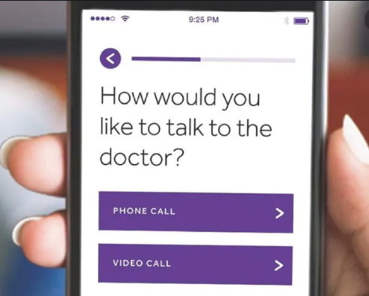
Telemedicine
Your Telemedicine Benefits
  Available for employees enrolled in the medical plan and all members of the household, regardless if enrolled in plan
  $0 copay
  24/7 access to an experienced, board-certified, state-licensed doctor
  Access via online video, mobile app, or telephone
  Teladoc doctors can treat a variety of health conditions, including:
    Cold and flu symptoms
    Allergies
    Bronchitis
    Skin problems
    Respiratory infections
    Sore throat
    Sinus problems
    And more!
Register your account or schedule a virtual visit!
· Go to Teladoc.com or call 1.800.835.2362 to register.
· Download the Teladoc app from Apple’s App Store or Google Play
Notes:
Teladoc is the telemedicine provider for the City of Tyler. This benefit is available to those employees and dependents enrolled in the City’s medical plan. Get 24/7 access board-certified doctors when it’s convenient for you! Teladoc is not only convenient it’s an affordable way to receive quality medical care. You have access to an experienced doctor anytime, anywhere by phone, online video or through the mobile app. You can FaceTime with a doctor from your living room in your PJs!
The City is providing this benefit as a $0 copay to health plan participants. You will not pay anything when utilizing this benefit. Teladoc doctors can treat a variety of health conditions, including: cold and flu symptoms, allergies, bronchitis, skin problems, respiratory infections, sore throat and sinus problems, just to name a few.
To register, go to Teladoc.com and create your account or call 1.800.835.2362, that’s 1.800.TELADOC. Teladoc also has a convenient mobile app for IPhones and Androids.

Slide 13
Flexible Spending Account
Medical Reimbursement and Dependent Care
Notes:
Next, we will discuss your flexible spending and dependent care options.

Slide 14


Flexible Spending Account (FSA)
Medical FSA
  $2,750 max contribution
  Pre-Loaded
  Debit Card
    Online Claim Reimbursement
  Up to $550 rollover
  OTC drugs covered
Dependent Care Spending Account
  $5,000 max contribution
    $2,500 if spouse also participates
Notes:
Your Flexible spending account administration is with Connect Your Care/Optum. The maximum election for 2022 is $2,750. Money you allocate to your FSA can be used for qualified out-of-pocket expenses through the plan year. Some qualified expenses include, copays, cost for glasses and dental fees. The funds are preloaded so you have access to your full election on January 1st. All FSA Participants will be sent a debit card that can be used on qualifying purchases or you have the option to pay for the purchase out of pocket and submit a claim form online to receive reimbursement. If you choose to use your debit card to pay for expenses, please make sure to still keep your receipts. While many fsa debit card swipes are automatically approved, Connect our Care may reach out on various transactions and request substantiation or backup for that transaction. If the requested documentation is not sent to connect your care in the timeframe they allot, your card will be deactivated until the documentation is received.
You will be able to rollover up to $550 into the 2022 plan year. Any funds over the $550 threshold will be forfeited after 12/31/2021 if they are not used. Lastly, over the counter drugs are eligible expenses to use your FSA funds on.
The dependent care annual election is $5,000. The election is $2,500 if your spouse also participates in this benefit. For more details on eligible FSA and Dependent Care expense see pages 18 and 19 in your benefits guide.

Slide 15
Dental & Vision Insurance
Notes:
Next up we have your dental and vision plan options.

Slide 16

Dental Plan Provided through Delta Dental
Group I – Diagnostic & Preventive Dental Services
Examinations | 2 X per year
Teeth Cleanings | 2 X per year
Fluoride Treatments | 2 X per year
Bitewing X-Rays | 1 X per year
The Plan Pays services at 100%
Group II – Basic Restorative Care Dental Services
Fillings
Routine Tooth Extractions
Root Canal Treatment
Periodontal Scaling & Root Planning
The Plan Pays 80% with a maximum calendar year benefit of $1,200
Group III – Major Care Dental Services
Crowns
Bridgework
Tooth Implants
Complex Oral Surgery Procedures
Complete Denture & Repairs
The Plan Pays 50% with a maximum calendar year benefit of $1,200
Group IV – Orthodontic Services (Limited to Dependent Children)
Orthodontic treatment (help fix patient’s teeth and set them in the right place)
Braces and clear aligners
The Plan Pays 50% with a maximum lifetime benefit of $1,000
This is an abbreviated list of services, see the carrier plan documents for full plan details.
Notes:
The City of Tyler’s dental care plan benefits through Delta Dental include 4 service types. Groups 1 through III all are applied to your $1,200 annual max benefit. Groups 2 & 3 include a $50 deductible for the individual and a $150 deductible for the family. The first Group we are going to discuss is Group I. This group is also referred to as Diagnostic and Preventive Care. This group includes coverage for you to get your teeth examined, cleaned, and receive fluoride treatments 2 times per year and bitewing xrays which are included once per year at not cost to you. The plan covers this group at 100%. The next group we are going to discuss is group 2, also known as Basic Restorative Care. This group includes coverage for fillings, routine tooth extractions, root canal treatment, periodontal scaling and root planning. These benefits are covered at 80%. Group III is referred to as Major Care and included coverage for crowns, bridgework, tooth implants, complex oral surgery procedures and complete denture and repairs. These benefits are covered at 50%. As a reminder groups one through 3 all go towards your $1200 calendar year benefit maximum. The benefits outlined are just an overview of your available benefits, not an exhaustive list. See the delta dental plan document for a full outline of your benefits. The last group is group 4, also known as Orthodontic Services. This group includes coverage for Orthodontic treatment, braces and clear aligners. These benefits are covered at 50% and have a $1000 lifetime maximum benefit.

Slide 17



Dental Plan Provided through Delta Dental
Visit a dentist in the Delta Dental PPO network to maximize your savings!
  Find a PPO dentist at deltadentalins.com
Discounts on hearing aids and one year of free follow-up care
62% average savings off retail hearing aid pricing, with a best-price guarantee of 5%
Call Amplifon at 888-779-1429
Find a PPO dentist:
1. Go to deltadentalins.com.
2. Enter your location.
3. Select Delta Dental PPO as your network.
4. Click Search.
Discount on LASIK eye surgery, including pre- and post-operative visits
40-50% off national average price
Call QualSight at 855-284-2020
For more information on Dental Insurance call Delta Dental at 800.521.2651 – Policy #18474
Notes:
City of Tyler dental plan participants have access to one of the biggest dental networks available through Delta Dental. Delta Dental Network providers agree to have reduced fees. You do have the option of choosing any dentist regardless of network, but risk paying more if you utilize an out of network provider. It’s easy to find a PPO dentist using Delta Dental’s online directory. Go to delatadentalins.com and enter your location. Select Delta Dental PPO as your network and then click search. Did you know you don’t need a dental card to be seen by your dentist. Just let them know you are covered by Delta Dental and then provide them with your name, date of birth, enrollee ID number and let them know your coverage is offered through the City of Tyler. You can also print an ID card by logging into deltadentalins.com. For additional details on your dental plan, see pages 12 and 13 in your benefits guide. For more information regarding your dental benefits offered through Delta Dental, call delta at 1.800.521.2651 Monday through Friday 8 a.m to 8 p.m. eastern standard time. The delta dental automated system is available 24/7. Did you know your Delta Dental plan gives you access to great discounts on laser eye surgery from QualSight and hearing aids from Amplifon? To take advantage of this preferred pricing, just give Amplifon a call at 888.779.1429 or QualSight at 855.284.2020. A dedicated representative will walk you through the program and help you pick a provider, make an appointment and receive your discount. Vision corrective services and Amplifon’s hearing health care services are not insured benefits. Delta Dental makes the vision corrective services program and hearing health care services program available to you to provide access to the preferred pricing for these services.

Slide 18

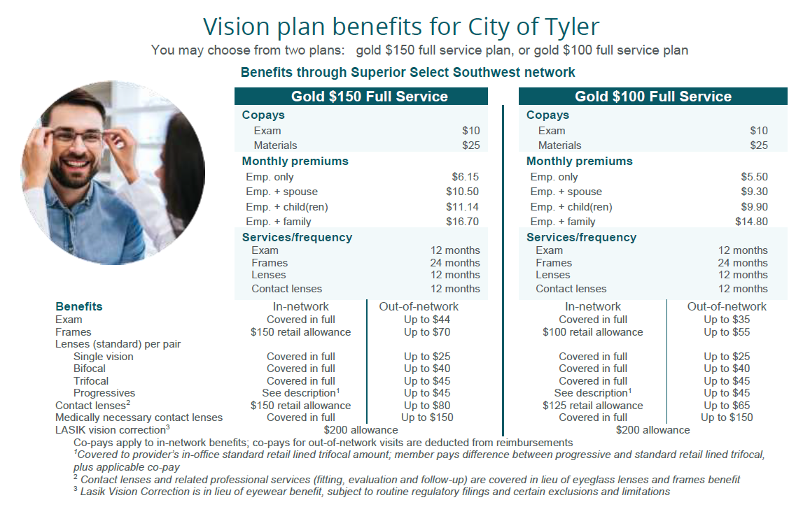

Vision Plan Provided through Superior Vision
This is an abbreviated list of services, see the carrier plan documents for full plan details.
Notes:
City of Tyler employees have their option of 2 vision plans. Members can choose from the the gold 150 buy up plan 1 and the gold 100 base plan 2. These plans essentially match. They both have an exam deductible of $10 and a materials deductible of $25. The difference between the 2 plans is the gold 150 buy up plan pays $150 towards a pair of frames once every 2 years and the gold 100 base plan pays $100 towards a pair of frames once every 2 years. For more information please see the benefit summary on page 14 in your guide, contact Superior Vision at 1.866.265.0517 or visit superiorvision.com or log into the member portal.

Slide 19
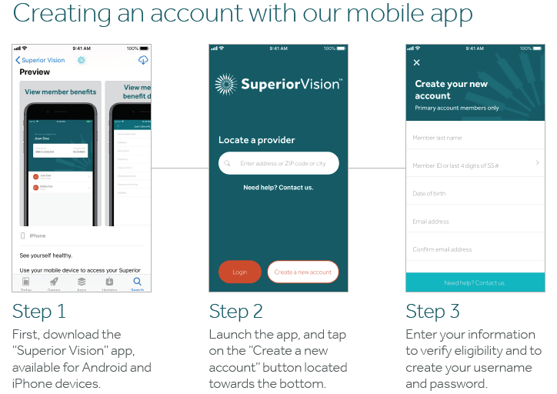
Vision Plan Provided through Superior Vision
New Vision Plan Features
  Glasses.com, 1-800 Contacts and ContactsDirect.com have partnered with Superior Vision
  Hearing Care Plan
    Included with Vision Plan Benefit
    Extends to family members of the employee, Dependents do not have to be enrolled on the vision plan
    Free hearing exams & discounts on hearing aids.
    4 year warranty on hearing aids vs. 3 years from the competition plus 4 year battery replacement
    Price match guarantee
    60 day money-back guarantee on hearing aid purchases
Hearing Care Plan
Call 1.888.494.1272 or go to www.superiorvision.yourhearing.com
Notes:
As a reminder, Superior Vision has partnered with Glasses.com, 1-800 Contacts, and ContactsDirect.com/SuperiorVision to give members an exclusive “in network” online retailer to order their prescription contacts & glasses. You can save up to 30% and have your contacts shipped to your home address. A Hearing Care Plan is also now available at no cost to employees. An additional perk is the program extends the discount to family members of the employee. Dependents do not have to be enrolled on the vision plan to use the discount services. Superior Vision: Hearing Care Program benefits include: Free hearing exams and discounts on hearing aids. Members receive fixed pricing on hundreds of hearing aids at network providers therefore ensuring they get the best price regardless of which network provider they visit. These discounted prices average 40% off the 2017 Consumer Guide to Hearing Aids pricing. Four year warranty on hearing aids vs. three years from the competition, Four year battery replacement vs. one from the competition ,Competitor price match guarantee + $50 ,60 day money-back guarantee on hearing aid purchases, Dependents do not have to be enrolled on the vision plan to use the discount services
For additional details about the hearing care plan call (888) 494-1272 or access superiorvision.yourhearing.com. With the free Superior Vision app, members can: Locate in-network eye care professionals, Review your benefits and the benefits of any dependents, See which benefits you have used and which benefits are currently available, View, print, or email your member ID card. To create your account first download the superior vision app. Next, launch the app and tap create a new account button which is located towards the bottom. Lastly, enter your information to verify eligibility and to create your username and password. If you need any help creating your account please call 1.800.507.3800 or vision superiorvision.com/contact.

Slide 20

Vision Plan Provided through Superior Vision
Visit our virtual open enrollment experience
    superiorvisionoe.com
      Plan Details
      Eye Health & Wellness
      Video
        . All who watch our video will be eligible for a chance to win a prize!
  Please note – enrollments will be completed through HealthFirst. The SuperiorVisionOE site is just informational.
Notes:
Your vision plan is anything but routine, so this year we created a one-of-a-kind virtual experience because we want you to get the most out of your vision plan while having access to valuable education and information about your benefits. Access the virtual experience by visiting superiorvisionoe.com on your computer or mobile device. You’ll feel like you’re really in the space! The gallery allows you to learn about important benefits included with your vision care plan and more about eye health and wellness and View a video to learn about the great features included with your plan. All who watch our video will be eligible for a chance to win a prize! Please note – enrollments will be completed through HealthFirst. The SuperiorVision OE site is just informational.

Slide 21


Dental & Vision Plan Premiums
 | Dental Plan
 | Employee Per Pay Period Contribution | Employee Monthly Contribution ($)
Contributions
Employee Only | $4.91 | $9.82
Employee +Spouse | $18.05 | $36.10
Employee + Child(ren) | $17.48 | $34.96
Employee + Family | $27.17 | $54.34
 | Vision plans
 | Gold $150 Buy-Up Plan 1 |  | Gold $100 Base Plan 2
 | Employee Per Pay Period Contribution | Employee Monthly Contribution ($) | Employee Per Pay Period Contribution | Employee Monthly Contribution ($)
Contributions
Employee Only | $3.07 | $6.15 | $2.75 | $5.50
Employee +Spouse | $5.25 | $10.50 | $4.65 | $9.30
Employee + Child(ren) | $5.57 | $11.15 | $4.95 | $9.90
Employee + Family | $8.35 | $16.70 | $7.40 | $14.80
Notes:
Here are your 2022 per pay period dental and vision plan premiums. As a reminder, there are 24 pay periods each year.

Slide 22
Short Term Disability & Life Insurance
Notes:
Next we will discuss your short term disability and life insurance options.

Slide 23


Short Term Disability / Basic Life and AD&D
Short Term Disability (employee paid)
Benefit | 60% of weekly earnings
Maximum Monthly Benefit | $1,200
Duration | Up to 26 weeks Up to 6 weeks (normal pregnancy)
Elimination Period | 7 days
All active regular non-civil service full-time employees are eligible to participate in this plan at a cost of $7.50 per pay period. (24 pay periods per year)
Basic Life Insurance and AD&D (employer paid)
Life Benefit | Employees : $10,000 Retirees: $5,000
AD&D Benefit | Matches Life Benefit for Employee
Line of Duty Benefit | Public Safety Officers - $10,000 AD&D
Retiree Life Benefit | $5,000
Life Age Reduction | 65th birthday - age 69 - 65% ($3,250)70th birthday - age 74 - 50% ($2,500)75th birthday and after - 30% ($1,500)
This is an abbreviated list of services, see the carrier plan documents for full plan details.
Notes:
Short Term Disability is a voluntary benefit offered by the City. Short Term Disability, if elected, kicks in when an illness or injury is extended beyond 7 consecutive days. short-term disability provides 60% of an employee’s covered weekly base earnings up to $1,200 per week for up to 26 weeks and up to 6 weeks for a normal pregnancy. All active regular non-civil service full-time employees are eligible to participate in this plan at a Cost of $15 per month. Basic Life and Accidental Death and Dismemberment or AD&D is a free benefit provided to you by the City. The policy covers $10,000 dollars in life insurance with a matching accidental death and dismemberment policy for active employees and a $5,000 life benefit for all retirees. The life policy pays out if there is a loss of life and the AD&D policy will only payout if the loss of life is due to an accident. This essentially doubles your life benefit. Dismemberment claims will pay a portion of your covered amount depending on the loss. AD&D does not cover retirees.
In addition to the basic life and AD&D policy, the City also covers Public Safety Officers with an additional AD&D amount of $10,000. Should a Public Safety Officer suffer a loss while in an act of duty, the line of duty benefit would payout in addition to the basic life and AD&D benefit, tripling your basic life amount. Retiree’s have a $5,000 basic life policy. Both active and retiree basic life policies are subject to an age reduction schedule.

Slide 24
Voluntary Life and AD&D Provided through Securian administered by Ochs
Employee
$10,000 increments
Elect up to $500,000
Spouse
$5,000 increments
Elect up to $250,000
Child
Elect $5,000, $10,000, $15,000, or $20,000
One election insures all children from live birth to age 26
A spouse is not eligible if also eligible as an employee
A child may only be covered by one parent
Line of Duty – Public Safety Officers receive an additional benefit – 100% up to $100,000
Employee Life
Increase by:
$10,000
Guaranteed issue up to $250,000 Once total coverage amount exceeds $250,000, all elections are with evidence of insurability
Child Life
Elect: $5,000, $10,000, $15,000, or $20,000
One election covers all eligible children
Enrolling beyond the guaranteed issue limit for employees and any election/increase in spouse life will require evidence of insurability and underwriting approval.
This is an abbreviated list of services, see the carrier plan documents for full plan details.
Notes:
Active employees can elect Voluntary Life and AD&D for themselves and for their dependents. Employees can elect in $10,000 increments up to $500,000 and spouse’s can elect in $5,000 increments up to $250,000 in voluntary life insurance. You may not add voluntary life coverage on your spouse if your spouse is an eligible employee. Note, Voluntary AD&D will match the life election for employees and spouses. An additional amount of AD&D will be paid to public safety officers that suffer a loss while in an act of duty. This amount will match current AD&D election, not to exceed $100,000 dollars. Employees can elect amounts of $5,000, $10,000, $15,000 or $20,000 dollars for their child or children. One election insures all children from live birth to age 26, and can only be covered by one parent if both parents work for the City of Tyler. As a reminder, spouse voluntary life rates are based off of the employee’s age. Also, voluntary life rates are age banded in 5 year increments and will increase the month following your birthday. If you have already enrolled in and are participating in the voluntary life insurance plan, during Open Enrollment, you can increase your coverage by $10,000 up to the guarantee issue amount of $250,000 without answering evidence of insurability. Also, if you have a dependent child or children you can elect amounts of $5,000, $10,000, $15,000 or $20,000 dollars without evidence of insurability. Enrolling beyond the guaranteed issue limit of $250,000 or increasing from $0 for employees and any election/increase in spouse life will require evidence of insurability and underwriting approval. Don’t forget, If you wish to change your beneficiary or make a change to your life insurance please call (903)363-0600 or email jmcgrew@tylertexas.com.

Slide 25
2021 Open Enrollment Recap
2 Medical Plan Options.
  Those who do not complete open enrollment and have a medical election will be defaulted into the Rose plan. All other elections will rollover.
Decision Support Tool
If you want to make changes, please be sure to download the handout with instructions on how to complete online enrollment or call Team Reosurces for assistance completing your enrollment.
Q&A Sessions and Online Enrollment Sessions
Remember to pick up a copy of the Enrollment Instructions, Benefit Summary and download your benefits guide which includes the information we discussed today and your premiums.
Notes:
As a reminder, you will have 2 medical plan options for the 2022 plan year. The Rose Plan and the Azalea Plan. The Rose plan mirrors the current medical plan we have in place. The Azalea plan is a new plan option you will have.
To help you decide which plan to choose, the City has implemented a decision support tool. PLANselect will be exclusive to the medical plan options. By now you should have received an email that includes the link to this tool. If you cannot locate this link – please reach out to Team Resources. This year’s open enrollment is a passive enrollment but all employees are strongly encouraged to explore and compare the 2 health plan options and choose the plan that best meets the needs of you and your family as well as review all of your benefit plan options. For those who do not complete the open enrollment process, and who are already enrolled in medical, will be defaulted into the Rose plan. All other current benefit elections will rollover. If you are planning to make changes to your benefit elections, please refer to the handout with instructions on how to complete your online enrollment. If you plan to make any changes to your life insurance or update your beneficiaries, please contact Jennifer McGrew at jmcgrew@tylertexas.com. Anyone needing help with their enrollment can call (903)579-3906. Anyone needing help with their enrollment can attend one of our Q&A sessions or Online Enrollment Assistance Sessions. The dates of those sessions will be on the next slide. Don’t forget to download your benefits guide, benefit summary and enrollment instructions which include the information we discussed today and your premiums.

Slide 26
Important Dates
Q&A Sessions:
  Wednesday, November 3rd: 10:30 a.m., 2:30 p.m. & 4:30 p.m.
    Rose Garden
  Thursday, November 4th: 8:30 a.m., 10:30 a.m. & 2 p.m.
    Rose Garden
  Friday, November 5th: 9 a.m., 11:30 a.m. & 2:30 p.m.
    City Hall – Council Chambers
Online Enrollment Assistance at CityU:
  Monday, November 1st: 1:30 p.m. – 5 p.m.
  Wednesday, November 3rd: 8 a.m. – 11:30 a.m.
  Monday, November 8th: 1:30 p.m. – 5 p.m.
  Friday, November 12th: 8 a.m. – 11:30 a.m.
Open Enrollment starts Monday, November 1st.
  Deadline to make changes is Friday, November 12th at midnight.
Notes:
We will be having several Q&A sessions to go over the new Medical Plan options available to you. We will be walking through these plans in more detail and will answer any questions you have about all of your benefit plan options. These sessions will be on Wednesday November 3rd at 10:30 a.m., 2:30 p.m. and 4:30 p.m. at the Rose Garden, on Thursday November 4th at 8:30 a.m., 10:30 a.m. and 2 p.m. also at the Rose Garden and on Friday November 5th at 9 a.m., 11:30 a.m. and 2:30 p.m. at City Hall in the Council Chambers. We will also have a few sessions CityU for those who need assistance completing the enrollment online. A member of the HealthFirst team will be onsite to help you with the online enrollment process. As a reminder, Open Enrollment will start on Monday, November 1st and run through Friday November 12th. All changes need to be made by midnight on the 12th.

Slide 27

Questions?
Benefit Questions, contact HR
  For HealthFirst online portal questions call November 12th Deadline 903.579.3906
Notes:
Thank you for participating in today’s 2022 open enrollment presentation for the City of Tyler. The benefit summaries included were just an overview of the benefits available to you, for more detailed information on your benefits please consult your benefit guide and for full details on benefits covered by each plan, please consult the plan documents and certificates of coverage. Don’t forget that the deadline for submitting your enrollment online is Friday, November 12th. If you have any questions about the information we covered today, please contact Team Resources at 903.531.1100 or attend one of the Q&A sessions listed. Thank you!

