Slide 1
Half Cent Sales Tax
Annual Work Plan and Budget
July 28, 2021

Slide 2
Each year the Half Cent Sale Tax Board will develop a proposed annual work program and an annual budget which it will recommend to the City Council for approval.
Each annual work program will include both the projects planned for the next fiscal year and those prior projects which are not finished. The 2021-2022 Annual Work Program and 2021-2022 Corporate Budget will be effective October 1, 2021.

Slide 3
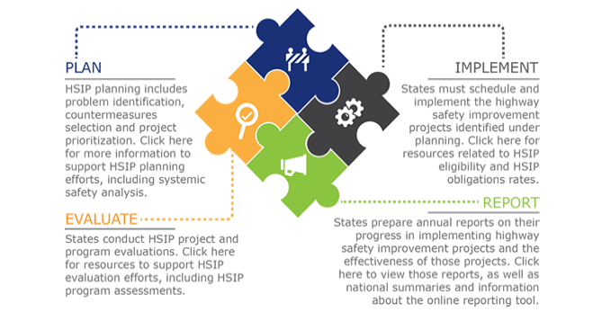
New Projects Added to Half Cent Work Plan
HSIP (Highway Safety Improvement Program) Projects:

Slide 4
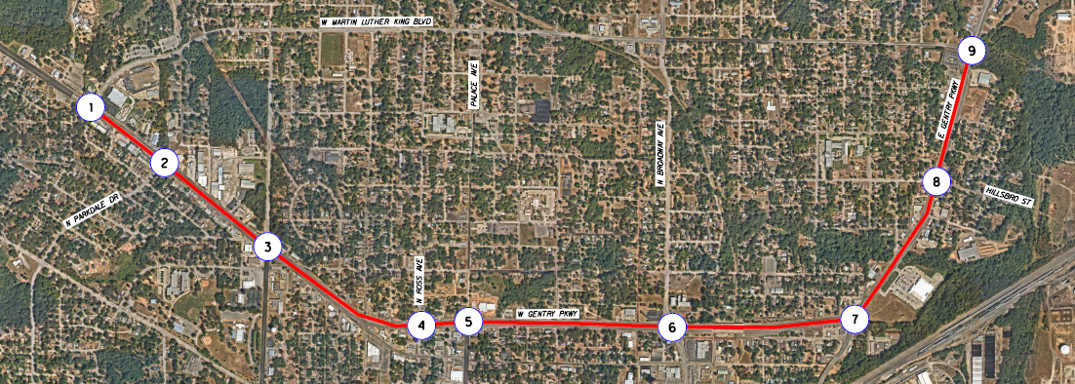
  Highway Safety Improvement Project – Gentry Parkway Corridor Improvements

Slide 5
  Highway Safety Improvement Project – Gentry Parkway Corridor Improvements
Install Cellular Communications
  Gentry Parkway at Beckham Avenue
Install Cellular Communications and Vehicle Detection
  Gentry Parkway at MLK Boulevard West
  Gentry Parkway at Parkdale Drive
  Gentry Parkway at Ross Avenue
  Gentry Parkway at Palace Avenue
  Gentry Parkway at Broadway Avenue
Reconstruction Traffic Signal and Pedestrian Improvements
  Gentry Parkway at Glenwood Boulevard
  Gentry Parkway at Hillsboro Street
  Gentry Parkway at MLK Boulevard East
 | City | TxDOT | Federal | Total
Engineering (10%) | $ 121,322.50 | $ - | $ - | $ 121,322.50
Contingency (5%) | $ 60,661.25 | $ - | $ - | $ 60,661.25
Construction | $ - | $ 121,322.50 | $ 1,091,902.50 | $ 1,213,225.00
Total: | $ 181,983.75 | $ 121,322.50 | $ 1,091,902.50 | $1,395,208.75

Slide 6
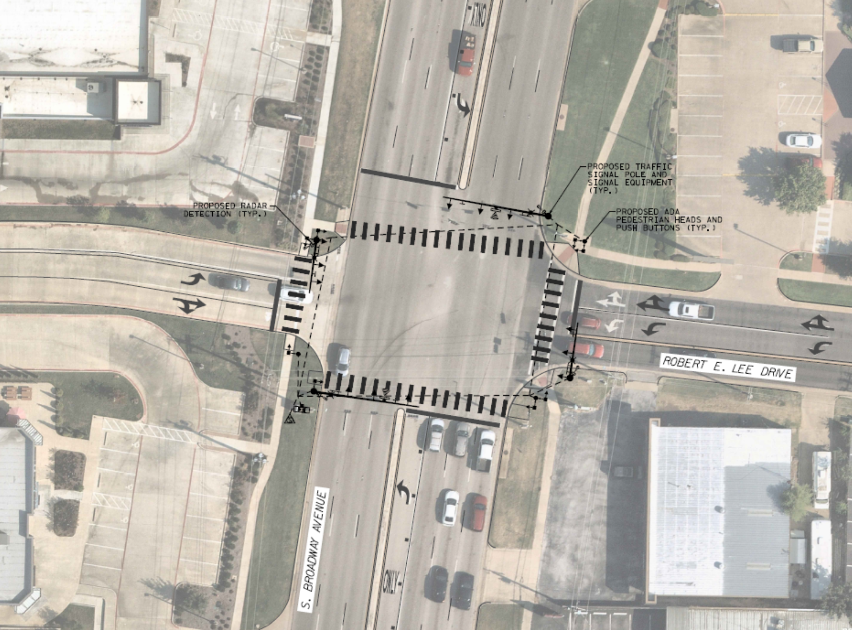
  Highway Safety Improvement Project – US 69 (South Broadway) at Robert E Lee Drive Signal Reconstruction
 | City | TxDOT | Federal | Total
Engineering (10%) | $ 39,699.20 | $ - | $ | $ 39,699.20
Contingency (5%) | $ 19,849.60 | $ - | $ | $ 19,849.60
Construction | $ - | $ 39,699.20 | $ 357,292.80 | $ 396,992.00
Total: | $ 59,548.80 | $39,699.20 | $ 357,292.80 | $ 456,540.80

Slide 7
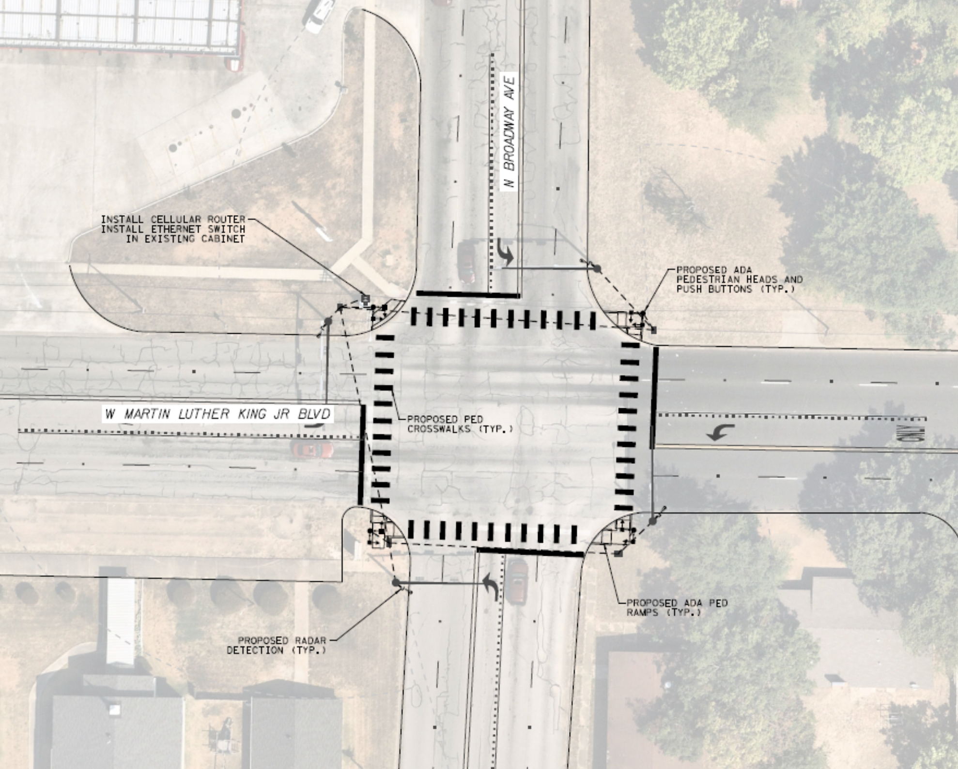
  Highway Safety Improvement Project – MLK Boulevard at N Broadway Signal and Pedestrian Improvements
 | City | TxDOT | Federal | Total
Engineering (10%) | $ 16,499.20 | $ - | $ - | $ 16,499.20
Contingency (5%) | $ 8,249.60 | $ - | $ - | $ 8,249.60
Construction | $ 16,499.20 | $ - | $ 148,492.80 | $ 164,992.00
Total: | $ 41,248.00 | $ - | $ 148,492.80 | $ 189,740.80

Slide 8
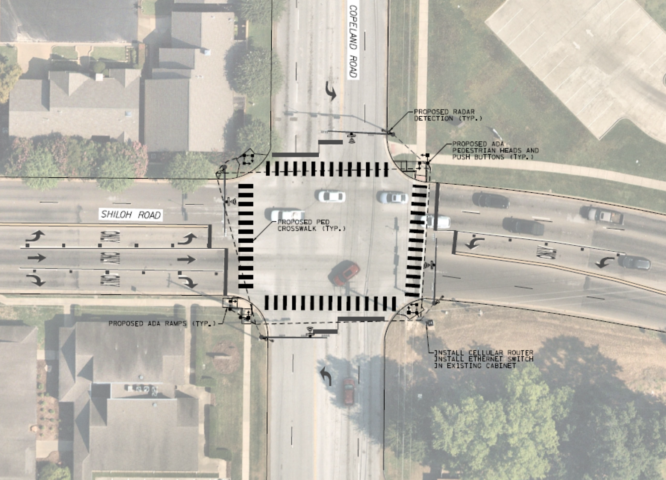
  Highway Safety Improvement Project – New Copeland Road Corridor Signal and Pedestrian Improvements
 | City | TxDOT | Federal | Total
Engineering (10%) | $ 45,833.10 | $ - | $ - | $ 45,833.10
Contingency (5%) | $ 22,916.55 | $ - | $ - | $ 22,916.55
Construction | $ 45,833.10 | $ - | $ 412,497.90 | $ 458,331.00
Total: | $ 114,582.75 | $ - | $ 412,497.90 | $ 527,080.65

Slide 9
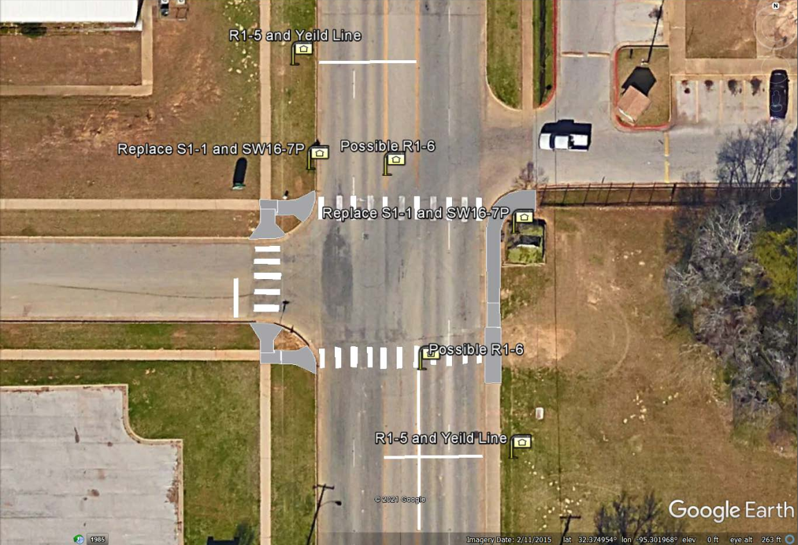
  Highway Safety Improvement Project – N. Broadway at 26th Street Pedestrian Crosswalk Improvements
 | City | TxDOT | Federal | Total
Engineering (10%) | $ 2,441.00 | $ - | $ - | $ 2,441.00
Contingency (5%) | $ 1,220.50 | $ - | $ - | $ 1,220.50
Construction | $ 2,441.00 | $ - | $ 21,969.00 | $ 24,410.00
Total: | $ 6,102.50 | $ - | $ 21,969.00 | $ 28,071.50

Slide 10
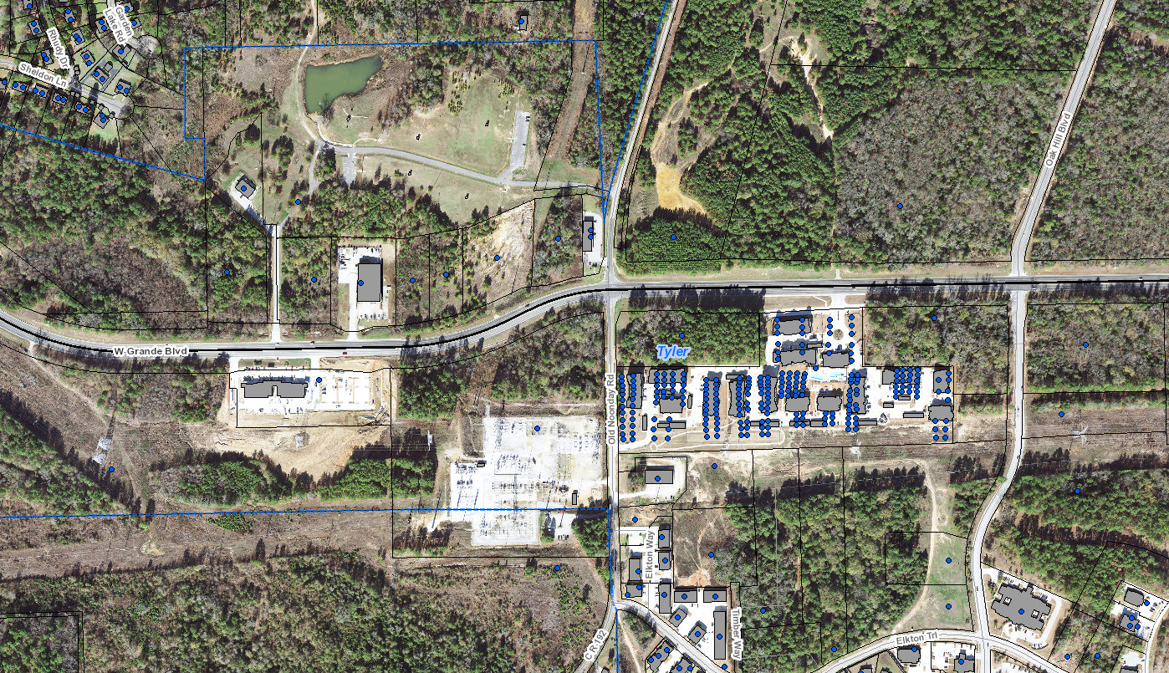
New Projects Added to Half Cent Work Plan:
  Signal at W Grande and Old Noonday Rd.
    Installation of a signal at the intersection of W. Grande and Old Noonday Rd. Recommended by the Traffic Engineer and Citizens due to the intersection being on an incline and curve.
    Estimated cost - $500,000

Slide 11
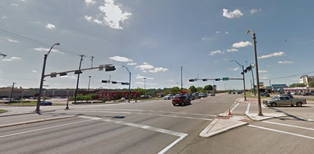
New Projects Added to Half Cent Work Plan:
  Traffic System Improvements:
    Various improvements recommended by Citywide Traffic Study

Slide 12
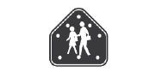
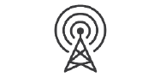
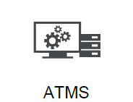
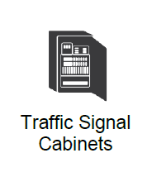
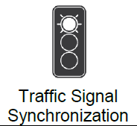
Traffic System Modernization Implementation Plan: Years 1 – 2
Estimated Cost: $1,364,761
  School Zone Flasher System
  Upgrade Communication System
  Upgrade Central Traffic Management System Software
  Start upgrading traffic signal equipment at priority intersections
    Cabinets, Controllers, Battery Backups, Vehicle Detection Systems, Emergency Preemption Systems
  Implement optimized signal timing for priority intersections (15 per year)
Traffic Signal
Equipment Upgrades
School Zone
Beacons
Comm Upgrade
Traffic Signal
Synchronization
ATMS

Slide 13



Traffic System Modernization Implementation Plan: Years 3 – 6
Estimated Cost: $6,340,622
  Upgrade signal equipment
    Cabinets, Controllers, Battery Backups, Vehicle Detection Systems, Emergency Preemption Systems
  Implement Signal Performance Measures
  Install CCTVs
  Remodel Traffic Management Center
  Recurring cellular modem costs
  Implement optimized signal timing for priority intersections (15 per year)
Traffic Signal
Equipment Upgrades
Traffic Management
Center
Signal Performance
Measures
Traffic Signal
Synchronization
CCTV

Slide 14
Traffic System Modernization Implementation Plan: Years 7 – 10
Estimated Cost: $ 7,144,785
  Upgrade signal equipment
    Cabinets, Battery Backups, Vehicle Detection Systems, Emergency Preemption Systems
  Install Dynamic Message Signs
  Recurring cellular modem costs
  Implement optimized signal timing for priority intersections (30 per year)
TRAVEL TIME
TO BROADWAY
5 MINS
Traffic Signal
Equipment Upgrades
Dynamic Message
Signs
Traffic Signal
Synchronization

Slide 15
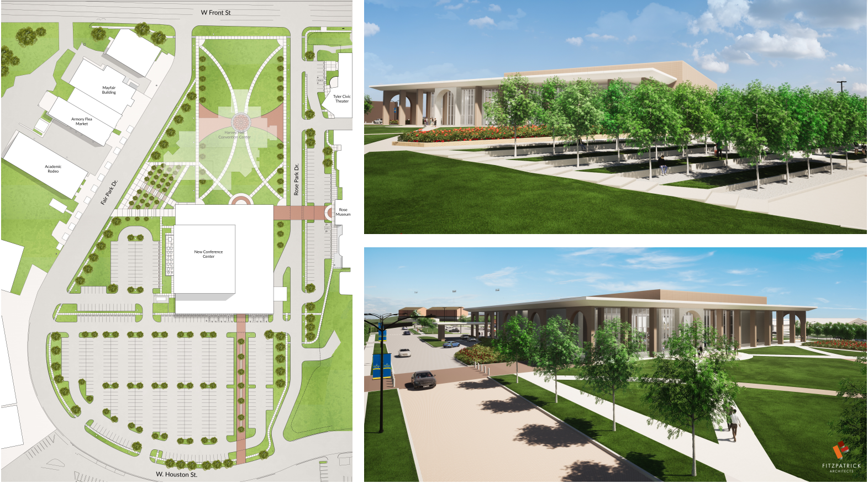
New Projects Added to Half Cent Work Plan:
  Rose Convention Center Development
    The City requests $3.25 million to begin the development of the new Rose Convention center, which will take the place of the Harvey Convention Center.
    Estimated Cost Year One - $3,250,000

Slide 16
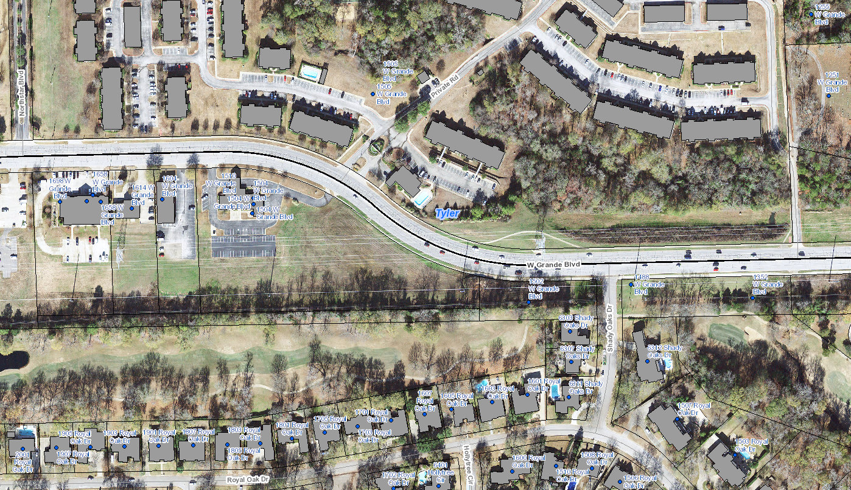
New Projects Added to Half Cent Work Plan:
  Traffic Barriers –
  W. Grande (Shady Oaks to Northstar Blvd.)
    Estimated cost - $1,500,000

Slide 17
New Projects Added to Half Cent Work Plan:
  Roy Rd. Extension
  Full Project Scope
    This project is expected to help with congestion from Cumberland High School, Jeff Davis Rd., and Rhone's Quarter due to increased development in that area.
    Estimated cost FY 21-22 - $292,363
    Estimated cost FY 22-23 - $573,841
    Estimated cost FY 23-24 - $4,565,459
    Estimated cost FY 24-25 - $4,702,423
    Estimated cost FY 25-26 - $2,421,748
    Estimated Total with inflation: $12,555,834

Slide 18
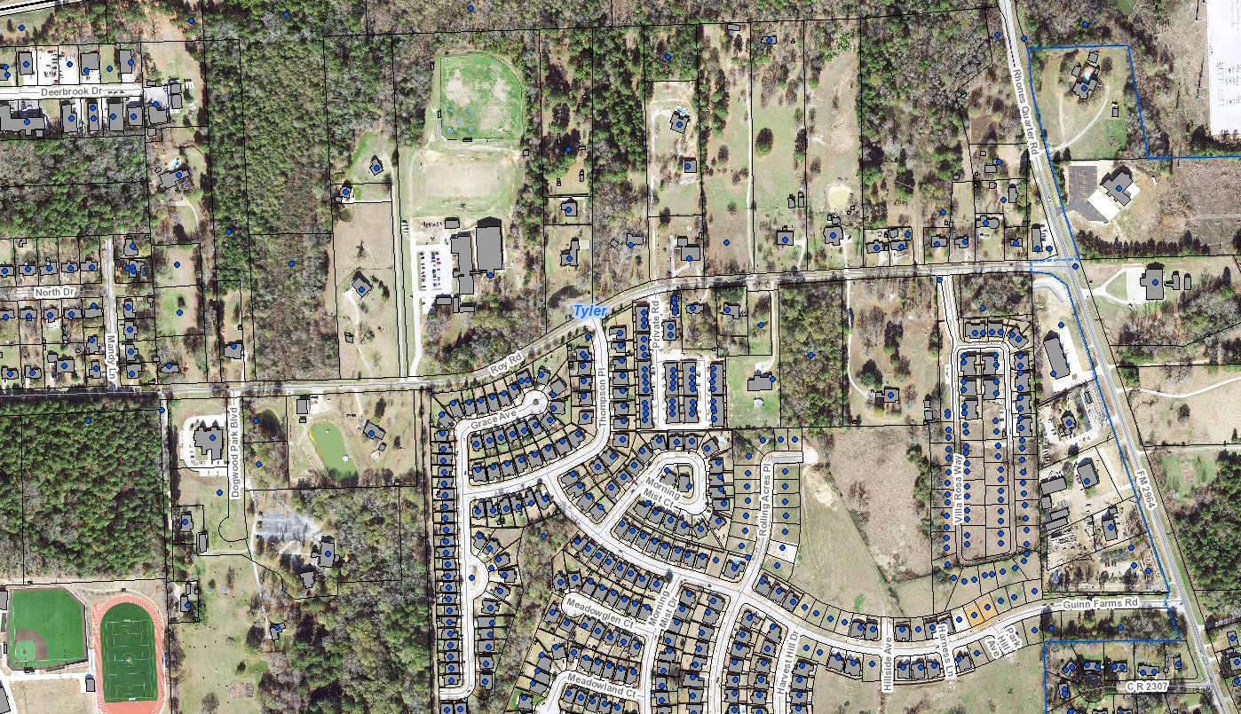
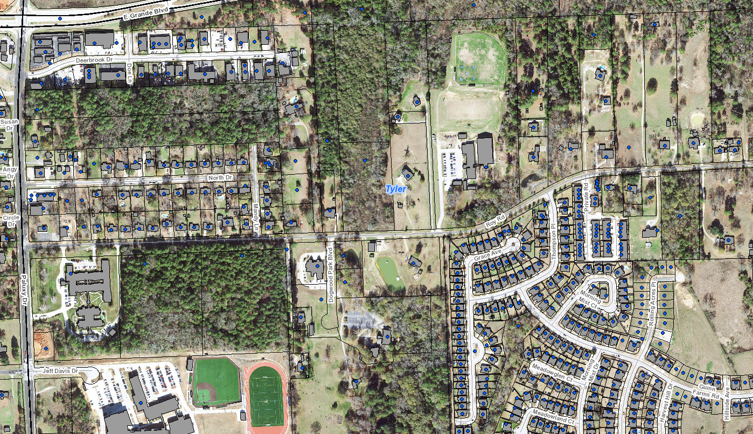
New Projects Added to Half Cent Work Plan: Roy Road Extension
Roy Road

Slide 19
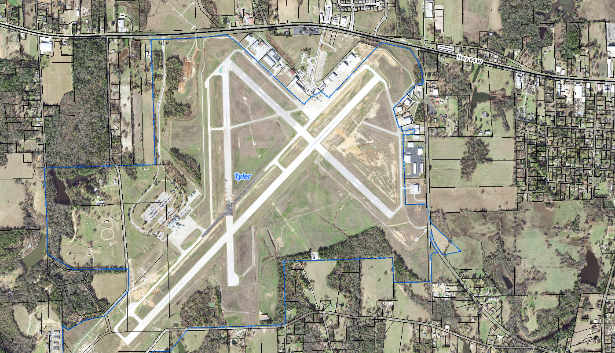
New Projects Added to Half Cent Work Plan:
  Reconstruction of
  Taxiway Alpha
    The existing asphalt pavement is severely deteriorated and has served well beyond its lifespan. The airport and FAA have programmed for its rehabilitation and plans to fund 90% of all associated costs.
    The project is scoped to remove all the old pavement and replace it with concrete pavement having the same weight bearing capacities of Runway 4-22
    Estimated project cost - $3,852,000
    Estimated Local share - $385,200

Slide 20
FY 20-21 Projects:
24 projects totaling an Estimated $18.23 million:
  Streets and Traffic
    Cambridge Road improvements
    Pavement Condition Assessment and Updates
    Reconstruction of Melinda Lane and Donna Drive
    2020 Asphalt Overlay
    2021 Asphalt Overlay
    Three Lakes Parkway Extension
    Reconstruction of Mirabeau Dr (Canal St to End)
    Year 1 - School Zone Flasher, Communications System and Signal Timing Upgrades
    Preliminary Engineering for Shiloh Road (SH 110 to Old Omen Road)

Slide 21
FY 20-21 Projects:
  Drainage
    Comprehensive Stormwater Master Plan
    Cloverdale Drainage Improvements
    Arbor Oaks Channel Replacement
    College Ave. Storm Sewer Repair
    Pabst / Bow Storm Sewer Repair
    Flat Rock Storm Sewer Repair
    Channel Wall Reconstruction (W Mud Creek - Shiloh and Donnybrook)
    Briarwood Estates Channel Improvements
    Holly Park Drainage Improvements
    Stagecoach Drainage Improvements
    Channel Wall Reconstruction (W Mud Creek - 400 W. Grande)
  Parks and Airport
    Lindsay Park Restrooms
    Rose Center Improvements
    Legacy Trails Phase 2
    Airport Masterplan

Slide 22
PROPOSED HALF CENT BUDGET,
REVENUE AND EXPENDITURES

Slide 23
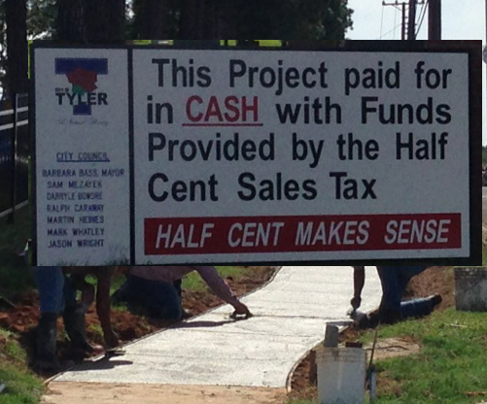
FY 21-22 Proposed Half Cent Budget:
Beginning Cash Balance: | $17,339,652
Revenues: | $16,177,514
Expenditures: | $18,582,087
Transfers In: | -
Transfers Out: | $3,250,000
Ending Fund Balance: | $11,685,079

Slide 24
On July 13, 2021
The Half Cent Sales Tax Board
Approved the Proposed Budget and Annual Plan

